Slide 1
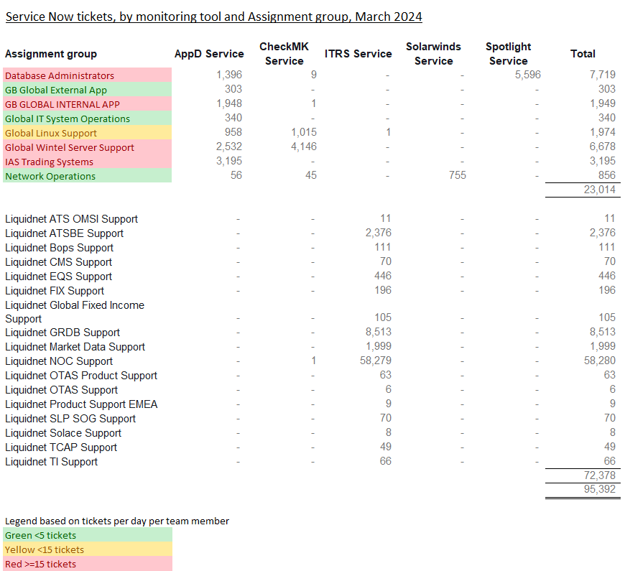
Event Trends / Noise Reduction Noise reduction is a pre-requisite to fast reaction times.
Noise Reduction Strategy
- Each team must be responsible and accountable for their own noise reduction / fine tuning
- Categorise and Prioritise events, drop some types of events that do not require immediate human action
- Stop alerting on non-Production
- Stop duplicate alerts AppD /CheckMK
- Fine tune performance thresholds to reduce transient or false alerts
- Work on chronic issues
- Continuous Improvement / Gardening

Slide 2
The plan
Each team is responsible for reducing the Noise around False alerting and Service Now tickets requiring no action.
Progress will be reported on a monthly basis.
Initial focus will be on the following queues
IAS Trading / EAS / Wintel Server Support and Database Administrators
Phase 2 will also include
Linux Support / GB Global Internal App
Why can’t we remove false alerts completely?
False alerts can be generated for a wide variety of reasons, such as:
P1 / P2 Incidents will always generate multiple tickets and, our focus will be on restoring service, not necessarily disabling alert policies in AppDynamics
Servers losing communication with the AppDynamics controller
Emergency Break Fix work taking place
Midweek code deployments
One incident creating multiple tickets
Network blips that auto-recover
No ability for AppDynamics to automatically close a ticket in Service Now when a condition clears
The above are just some examples as to why the number of incidents generated in Service Now will always be variable

Slide 3

IAS – Monitoring Review
IAS have launched a review of the monitoring configuration we employ across the application estate we are responsible for. This review is taking place in an effort to reduce the overall number of tickets we receive that do not require investigation / resolution and also to allow us to focus on quality of the information contained in the ticket, aiding the learning process for all members of the team.
What is the Problem?
IAS receive thousands of tickets each month into the ‘IAS Trading Systems’ queue in Service Now. A significant proportion of these require no action as they are generated during known maintenance windows and are, closed without investigation. This leaves IAS open to potentially closing valid alerts, introducing risk to the business. The sheer quantity of alerts we receive however, makes proper investigation of each alert impossible to achieve in any reasonable timeframe.
When tickets are closed, we frequently see close notes such as ‘Caused by CPU spike’, with no further explanation of what caused the spike. Equally, we will see close notes such as ‘due to weekend maintenance’ when in fact, the issue was nothing of the sort.
How do we intend to tackle this issue?
We have implemented a phased approach in order to deal with these tickets.
Phase 1: Get the overall number of erroneously generated tickets down using all available means
Adding Alert Suppressions into AppDynamics, omitting policies from sending alerts during periods of known maintenance or inactivity on the platform eg; TMM will not send any alerts between 00:00 Saturday and 14:00 Sunday. Marker will not send any alerts during the same period in addition to between 18:00 and 00:00 Monday to Friday, as it is not used in the US
Reviewing alerts daily, seeing what we actually have generated on a daily basis, then evaluating whether these alerts are really necessary ie; Do they need to be acted upon? If not, we have set up alert suppressions or changed rule configuration to omit false negatives
Perform trend analysis on the numbers of tickets generated per day (Tuesday vs Tuesday) and week by week to try and catch any outlying error reporting that we do not need to action
Removing rules from policies so that they may flag on a dashboard, but not generate tickets. This is useful in the event of a database CPU spike or similar, which we cannot resolve but may need to know about should other issues manifest at similar times
Feedback changes to Development / Product Owners to advise them what we are doing, why and asking them to ensure these changes are reflected in future ‘Monitoring by Code’ changes that are implemented

Slide 4
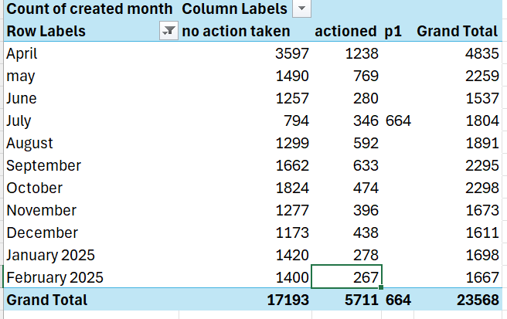
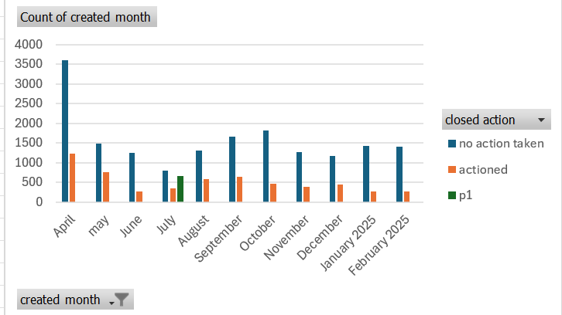
IAS – Monitoring Review
Phase 2: Focus on Quality
All tickets are to be closed using the correct ‘Close Code’ in Service Now. This is not something that can be automated and will involve an ongoing review process to ensure this is happening
Tickets are to have clear, concise information added to the Close Notes section eg; instead of using the phrase ‘CPU Spike’, we need to detail what caused the CPU spike, what was investigated to ascertain the offending process causing the spike and how it was dealt with?
Make sure the ticket reflects the correct application, application instance, regions affected. This is designed to enable trend analysis and for us to identify the heavy hitting systems, allowing resource to be directed according to need
When introducing a new application to the estate, monitoring is to be implemented on a ‘soft live’ basis, whereby no integration with Service Now will take place until initial teething issues have been identified and ironed out in what we’re monitoring, and how
How are we progressing?
The review started at the beginning of May, using April 2024 figures as our benchmark. Phase 1 is now complete on the IAS trading queue which can be seen from the graphs to the right which show a significant reduction month on month since the reduction of alerts task force began in May.
We are also in the process of getting the SNOW team to create a new closure code- investigated and found to be no further action required664 tickets generated on 19th July during the P1 crowdstrike outage which has distorted our July figures
September ticket count increased by 20%, the task force team will start running weekly calls to identify the top offenders and put a plan in place to reduce the false alerts again
October ticket count remained high however we have taken corrective action over the last few weeks by adding alert suppressions for tprepo during maintenance windows. We have also switched of DB blocking alerts for DMS as there was no value in these alerts, we will review these further with DBA. Triggers have been changed for adapters so that we will get alerts after 3 events. CRS health rules have been changed to alert only if feed is not received at a certain time. Ignore strings have been added for tpvol and dms to reduce known error alerts.
In November we have reduced the alerts by 27% by implementing the steps listed above and closely monitoring the ticket count daily.

Slide 5
IAS – Monitoring Review
When do we expect this work to be completed?
Whilst we expect this to be an ongoing body of work, we believe we will show significant differences in the numbers of tickets generated in total, in addition to enhancing the quality of the information contained therein by the end of June 2024.
The initial work has been done in the EMEA region and we will involve the team in APAC when we have shown further progress on the strategic application stack, allowing them to follow the same steps for the legacy estate.
We are unable to put a target on exactly how many tickets we will eliminate by these actions but are satisfied that the number will be significant and will enable us to provide better quality data to the business.
The total reduction will of course be dictated by new systems being brought into the IAS area and, any gaps that arise as part of this review.
Why can’t we remove false alerts completely?
False alerts can be generated for a wide variety of reasons, such as:
P1 / P2 Incidents will always generate multiple tickets and, our focus will be on restoring service, not necessarily disabling alert policies in AppDynamics
Servers losing communication with the AppDynamics controller
Emergency Break Fix work taking place
Midweek code deployments
One incident creating multiple tickets
Network blips that auto-recover
No ability for AppDynamics to automatically close a ticket in Service Now when a condition clears
The above are just some examples as to why the number of incidents generated in Service Now will always be variable
Next Steps
All work that has taken place has been on the ‘IAS Trading Systems’ queue. Once Phase 1 has been completed and we have moved to ‘focus on quality’ for IAS Trading Systems, we will commence Phase 1 on the ‘GB GLOBAL INTERNAL APP’ queue, which serves the legacy ICAP stack of systems including GUIBOS, ICAP TMS, Datatec etc
This will require input from all regions. Lessons learned from the IAS Trading Systems queue will be communicated before the process commences to all Global team members, with a specific focus on those in Manila.

Slide 6
IAS – Monitoring Review
How have these statistics been obtained?
Using report filters in Service Now, related to the IAS Trading Systems queue, we have ascertained that for 2023;
The total number for Service Now tickets raised for was 43481
23031 were closed with the code ‘No Action Required’, ‘False Alert’ or ‘Cancelled by Caller’
9323 tickets were duplicates. This has been ascertained by omitting rows with the Updated Time, Assigned To and Closed Notes where they are identical
1852 were closed with the notes ‘No Longer Violating’
724 reference ‘End of Day’ in the close notes
119 reference ‘Weekly Restart’ in the close notes
This leaves a total
of 8432 actionable alerts

Slide 7
EAS – Monitoring Review
Known/Identified Contributors for EAS alerts causing noise
As part of our SOP, we assess each alerts/incidents upon receipt to segregate actionable alerts from false or ignorable alerts and leverage the SNOW close code for this purpose.
Ignorable / False Alerts:
APPD Controller issue or network connectivity issues impacting APPD Controller.
Alerts that occurred during maintenance period.
Scheduled events such as Windows patching, Application upgrades/releases
Special events such as DR Testing.
Recurring Actionable alerts:
Memory spike issues
CPU spike
Disk Space issues
Service or Process failures
Connection count below the threshold / disconnection count above the threshold
Error events in the logs
Heart-beat issues (i.e process/service hanging, lost connection, etc)

Slide 8

Highlights as of January 2025:
DECREASED NON-ACTIONABLE ALERTS
Non-actionable or ignorable APPD ticket volume has decreased by 43.02 % for the month of January in reference to December 2024’s “No Actions Done” alert volume.
INCREASED ACTIONABLE ALERTS
Actionable APPD ticket volume has increased by 76.47 % for the month of January in reference to December-2024 “Actioned” alert volume.
Main contributors:
We’ve received multiple MQ alerts due to DTCC SSL certificate renewal.
Connectivity issue with RIMS (INC17344738) that caused multiple APPD Analytics logs alerts for the adaptors connecting to the RIMS Database (hosted in FIS).
Actionable vs Ignorable/Non-actionable Alerts as of January 2025 :
WeekNum consideration: each week begins on a Monday and ends on a Sunday

Slide 9
Highlights as of January 2025:
WEEKEND ALERT REDUCTION
Weekend alerts have been significantly reduced after amending APPD Policies to just send us notification emails for weekend failures/alerts instead of raising individual ServiceNow Ticket.
The January weekend alerts (week 1) are all attributed to the MQ SSL Certificate renewal which has been done over the weekend.

Slide 10
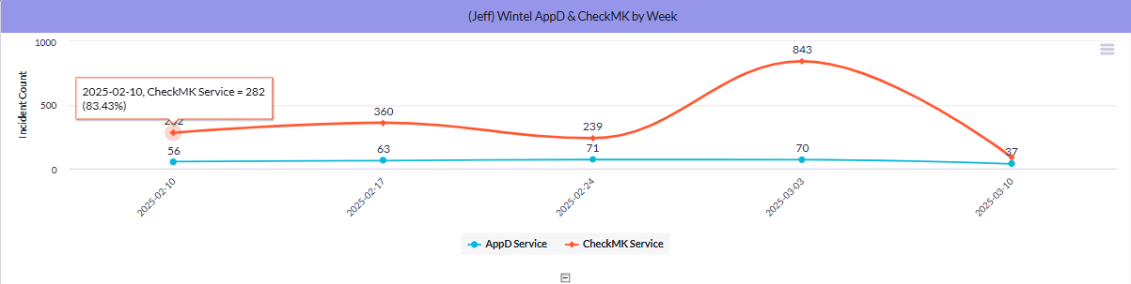
Wintel – Monitoring Review
Wintel’s monitoring noise stems from two automated alerts from CheckMK and Appd.
What is the Problem?
Lack of needed fine tuning with the monitoring tools has led to an increased amount of non-actionable noise that negatively impacts teams’ ability to respond to alerts.
Wintel, along with other platform teams, is continuing to fine-tune incoming alerts. As new noise-generating tickets are identified, available resources are adjusting the alerts. The results depend on how much time and resources can be allocated to this effort.

Slide 11
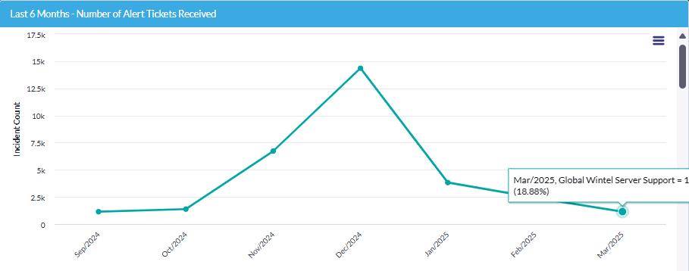
Wintel – Monitoring Review
How Are We Progressing?
Adjust server availability health threshold to reduce ticket generation – Complete
Identify application alerts that are driving noise (Active Directory Monitoring, Availability Alerts) - Restarted for the New Instance
Fine Tune CheckMK Alerts to eliminate non-actionable alerts – Restarted for the New Instance
Established a process to turn off CheckMK/alerting during patching and site-wide activity – Restarted for the New Instance
Roll Out The new CheckMK monitoring platform – Complete
The deployment of the new checkmk has caused a significant increase in our alerting. We continue to finetune these alerts to replicate our success in the past 6 months.

Slide 12
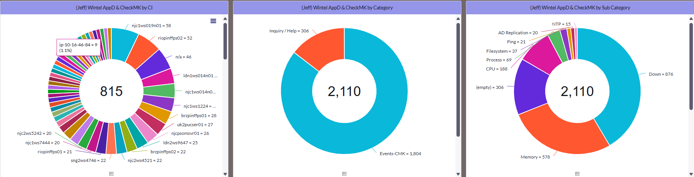
Wintel – Monitoring Review
Approach: Identify the top Talkers: The following action has been applied
Setup a dashboard that will address top talker identification - Complete
Ensure tickets are consistently categorized to improve noise identification. Currently, incoming tickets are uncategorized, making it harder to pinpoint their source. Categorization depends on other stakeholders, and Wintel is working on this.. - Ongoing
Schedule weekly ticket noise analysis - Ongoing
Create action plans on identified noise and execute them:
Disable Active Directory Alerts - Done
Adjusted Availability Alerts Ticket – Done
Checkmk ICMP alerts – Done
Checkmk Cluster Alerts - Done
UCS Alerts - Ongoing
ESX Alerts - Ongoing
Higher-than-expected tickets from the first week of March are being investigated. There's no change in the trajectory of ticket noise remediation. Actions for engineering and Wintel ops are ongoing.

Slide 13
DBA – Monitoring Review
Approach: Identify the top Talkers: The following action has been applied
- Each team must be responsible and accountable for their own noise reduction / fine tuning
- Categorise and Prioritise events, drop some types of events that do not require immediate human action
- Stop alerting on non-Production
- Stop duplicate alerts AppD /CheckMK
- Fine tune performance thresholds to reduce transient or false alerts
- Work on chronic issues
- Continuous Improvement / Gardening
Current Progress:
As we continue to fine-tune availability alerts, total Spotlight alert is trending downwards in the last few months, albeit with a small increase in January.
To Date focus has been on Removing Non-Prod alerting and fine-tuning alerting threshold.

Slide 14
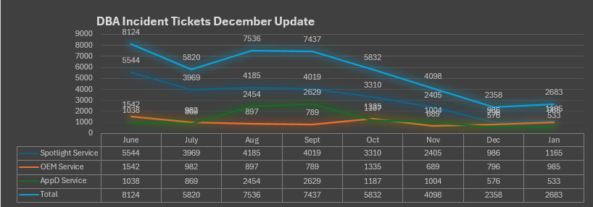
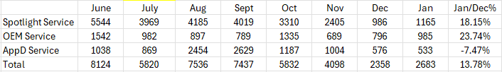
DBA – Monitoring Review
DBA monitoring noise stems from 3 Sources Spotlight, OEM and AppD.
What is the Problem?
Lack of needed fine tuning with the monitoring tools has led to an increased amount of non-actionable noise that negatively impacts teams’ ability to respond to alerts.
Month of December
We are making a slight increase on Spotlight alerts – as we come out from various change freeze in December. It is not a big increase and we continue to streamline the alerts matrix. OEM has returned to more normal level since fixing the mis-config in October, albeit with slight increase. AppD remains in consistent level with a small reduction from previous month. We are continuing to explore further streamline opportunity removing duplication of alert metric across various tools.
Total tickets up by 13.78% compares to December.

